Slide 1
Software Engineering
Week 01 Lecture 01

Slide 2
What is Engineering?
Engineering is the application of scientific and practical knowledge in order to invent, design, build, maintain and improve system and processes etc.

Slide 3
What is Software?
Collection of integrated programs.
Carefully organized instructions and code written by programmers.
Computer programs and associated documentations such as requirements, designs and user manuals.

Slide 4
What is Software Engineering?
An engineering discipline that’s concerned with all aspects of software production.
According to IEEE’s definition, software engineering is “The application of a systematic, disciplined, quantifiable approach to the development, operation and maintenance of software”

Slide 5
So, how will you start to develop a software?
Exam Management System
Goal Management System
LMS ?
Notes:
You should know some programming language.

Slide 6
Golden Circle
You want to be successful in life start thinking every goal and task in terms of the Golden Circle.
https://www.youtube.com/watch?v=qp0HIF3SfI4
Simon Sinek

Slide 7
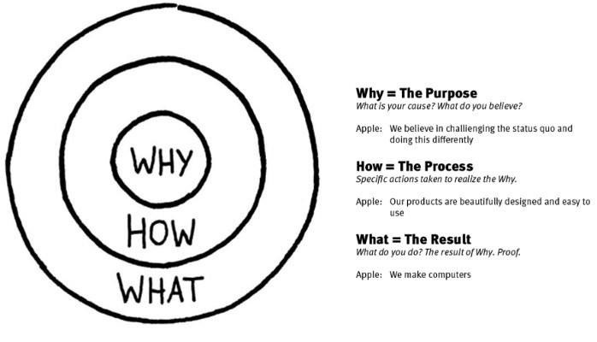
Golden Circle
Notes:
They think inside out
You should think of WHY of your life. Why you want to do SE or engineering?
If you get your WHY straight, Then think how you can do this?
And at the end think of the result.

Slide 8
CLIENT’S REQUIREMENT
Biggest challenge: what client wants?
Notes:
And when you’re making a product, why would your client/user buy it?

Slide 9
DEVELOPER UNDERSTANDING
How to communicate to developer what customer wants?
Notes:
Team lead’s responsibility to communicate properly.

Slide 10
WHAT IS BEST SOFTWARE DESIGN
What is best way to write the code?
One Developer write everything in the main method other make classes.
One make 2 classes and other make 10 classes.
Notes:
Programming conventions.

Slide 11
MANAGING SOFTWARE DEVELOPMENT
Task Division and Running the project in parallel.
How different developers work on same code file ?
How to maintain history of the code and changes so bug can be tracked?

Slide 12
COMPLETING THE PROJECT ON TIME
Work Division
Communicating with Client
Iterative vs waterfall
Notes:
Equal division is necessary to avoid sense of discrimination in members.
Division related to task is important as we have seen the example of same code different programmers.
How much your client should be involved? Less -> disadvantages, advantages… More -> advantages/disadvantages

Slide 13
VERIFICATION AND VALIDATION
Test that what we have developed is the requirement of the customers (have we developed right thing?)
Test what we have developed is working fine (have we developed rightly?).
Notes:
To ensure software quality.
Verification is the process of evaluating a system or component to determine whether it meets the specified requirements and standards. This involves checking the system design, code, and other deliverables to ensure they meet the requirements and standards. Verification activities include reviews, inspections, and testing.
Validation, on the other hand, is the process of evaluating a system or component during or at the end of the development process to determine whether it meets the customer's needs and expectations. This involves testing the software in the context of the user's environment to ensure it performs as expected and meets the user's needs.

Slide 14
DEPLOYMENT
Deploying the Project
End user Training or onboarding

Slide 15
SUMMARY
Understanding the client
Writing Requirement so the developer can understand
Software Design
Software Development
Software Testing
Software Deployment

Slide 16
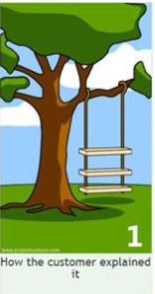
BAD REQUIREMENT: HOW THE CUSTOMER EXPLAINS
Notes:
Customers don’t have in-depth knowledge of the system. They tell you what they want their product to have, perform and look like.
So, it is important for the PM to understand the client’s needs and match them with his expertise before starting.

Slide 17

BAD REQUIREMENT:

Slide 18
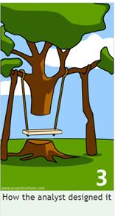
BAD REQUIREMENT:
Notes:
System analyst is an IT professional who analyzes, designs, and implements information systems that support business operations. They work closely with software developers, project managers, and end-users to gather requirements and translate them into technical specifications that can be used to create software solutions.

Slide 19

BAD REQUIREMENT:

Slide 20

BAD REQUIREMENT:
Notes:
We don’t even know how to document our project.

Slide 21

BAD REQUIREMENT:
Notes:
The necessary files and libraries to the user's system, configuring any necessary settings, and creating other access points for the user to launch the software.

Slide 22
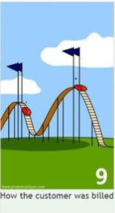
BAD REQUIREMENT:

Slide 23

BAD REQUIREMENT:

Slide 24
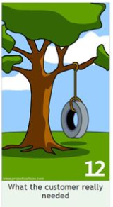
BAD REQUIREMENT:

Slide 25

WHAT HAVE YOU LEARNT IN THIS CLASS
Understand your Client.
Communicate with Developers
Make a Better Software Design.
Develop a Software according to the Design
Working in Teams
Software Testing (a bit)

Slide 26
PROJECTS
Select Project.
Dream Software with Small functionality.
You need to submit your project statement in next class.
Notes:
A project statement is a document that outlines the goals, objectives, scope, and deliverables of a project. It provides a clear and concise summary of what the project is intended to achieve, and serves as a guide for project planning, execution, and management.
A goal is a broad, general statement of what is to be achieved.
An objective is a specific, measurable, and time-bound statement of what needs to be accomplished to achieve a goal.

Slide 27
Proposal Writing
Proposal writing is the process of creating a persuasive document that outlines a proposed plan or solution to a particular problem or need.
The purpose of a proposal is to convince the intended audience for a specific course of action or to support a particular idea or project..

Slide 28
Tips for Proposal Writing
Understanding the audience
Define the problem
Present a solution
Make a persuasive argument
Be clear and concise
Edit and revise

Slide 29
Understanding the audience
Before writing your proposal, you should research and understand the needs and expectations of your audience. This will help you tailor your proposal to their specific needs and concerns.

Slide 30
Define the problem
Clearly define the problem or need that your proposal is addressing. Make sure you demonstrate a deep understanding of the issue and its implications.

Slide 31
Present a solution
Provide a well-researched and well-thought-out solution to the problem. Your solution should be practical, feasible, and cost-effective.

Slide 32
Make a persuasive argument
Use persuasive language and logical arguments to convince your audience of the value of your proposal. Use statistics, case studies, and other evidence to support your claims.

Slide 33
Be clear and concise
Keep your proposal concise and easy to read. Use headings and subheadings to organize your information and avoid using jargon or technical terms that your audience may not understand.

Slide 34
Edit and revise
Before submitting your proposal, make sure to proofread and edit it thoroughly. Ask a colleague or mentor to review it and provide feedback.

Slide 35
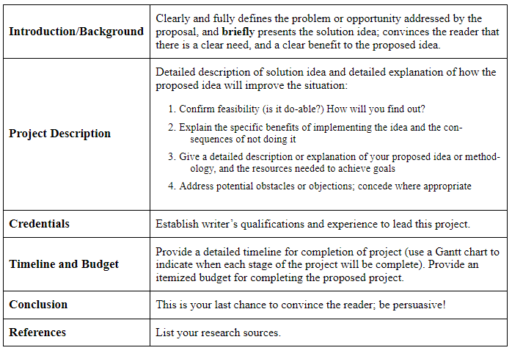
Sample Proposal Organization

